Slide 1
Nuclear Fuel Performance
NE-533
Spring 2022

Slide 2
Last time
If you want to opt into the paper project 2, please do that asap
Reminder, MOOSE project due April 26
Covered RIA and LOCA type accidents
RIA is often caused in PWR/BWR by control rod ejection/drop
Shorter pulses have greater impact than longer pulses (given same energy deposition)
Effects of RIA depend on burnup includefission gas, FCMI, oxide layer, hydrides, cladding pressure, etc
In loss of coolant accidents (LOCA), the fuel and cladding experience increases temperature and decrease in coolant pressure – occurs more slowly than a RIA
Accident tolerant fuel includes different fuel and cladding materials to increase time before catastrophic behavior during an accident

Slide 3
MOOSE Project Part 2
0.5 cm
0.1 cm
0.002 cm
Fuel pin dimensions listed – 2D RZ
Assume reasonable values for thermal conductivities, constant
Utilize axial T_{cool}, with T_{cool}^{in}= 400 K, reasonable flow rate, heat capacity, etc.
Utilize axial LHR, with LHR⁰=150 W/cm
Solve temperature profile for:
@ z=0.25, z=0.5, z=1
Solve for centerline temperature vs time
Transient: Volumetric/Areal heating rate
LHR⁰(t) = LHR⁰*(1-EXP(-0.1*time))+50 for up to t=100
@ z=0.25, z=0.5, z=1
Find location of peak centerline temperature at steady-state and at t=100 in transient
1 m
Fuel
Gap
Cladding

Slide 4
Limiting phenomena

Slide 5
Limiting Phenomena
Concerning limiting phenomena, some criteria have been established for the UO2 and MOX fuel designs
Engineering must demonstrate that all relevant parameters fulfill those criteria at any time from the loading of the fuel to reprocessing, or during long-term storage
The key performance limiting phenomena are Pellet-clad mechanical interaction; Cladding elongation and assembly bow; Cladding oxidation and hydrogen pickup; Cladding wear; Power to melt; Fuel rod internal pressure; Departure from nucleate boiling; Normal operation limits

Slide 6
Limiting Phenomena
PCMI
PCMI is a complex process with a maximum risk for failure when the fuel pellet to cladding gap closes firmly and the reactivity of the fuel is still high
The risk is enhanced by pellet fragments inducing a local shear strain on the cladding, and by the chemical interaction kinetic at the interface
In order to prevent SCC, the cladding hoop stress calculated for normal operation and transients is limited
The extent of the total permanent hoop strain is limited during the whole lifetime of the fuel rods, typically to 1%

Slide 7
Limiting Phenomena
Cladding elongation and assembly bow
During irradiation, the anisotropic character of the cladding material and the preferential migration of vacancies and interstitials in specific lattice planes drive an overall cladding axial growth, activated by the fast neutron flux
When contact is established between the pellet and the cladding, pellet axial elongation causes an additional axial cladding strain
This can lead to fuel rod bow with pitch reduction between the rods, reducing thermal margins
Differential elongation of guide tubes in a PWR assembly can lead to an overall assembly bow

Slide 8
Limiting Phenomena
Cladding oxidation and hydrogen pickup
For the ZrO2 formation at the cladding waterside surface, a typical criterion is related to the ASTM criterion of a maximum cladding wall thickness reduction of 10%, which corresponds to an oxide thickness of the order of 100 microns
When the hydrogen concentration in the cladding exceeds the solubility limit, 70–100 ppm by weight at operating temperatures, zirconium hydrides will form
The impact of hydrides on key mechanical properties depends strongly on hydride distribution and orientation
Oxidation and hydrogen pickup are increasingly important at higher exposures, as the dependence on burnup is nonlinear

Slide 9
Limiting Phenomena
Cladding wear
The criterion for cladding wear at the contact points between grid spring/dimples and the fuel rod is often also related to the ASTM criterion of a maximum cladding wall thickness reduction of 10%
More wear is technically acceptable, as evidenced from operational experience

Slide 10
Limiting Phenomena
Power to melt
The use of uranium dioxide or MOX provides a comfortable power to melt margin
The melting temperature decreases slightly with burnup, but remains above 2750C
At high burnup, above 50 MWd/kgM, considering the fuel thermal conductivity decrease, the power to melt was estimated to be around 600 W/cm, which is an unrealistic high LHR

Slide 11
Limiting Phenomena
Fuel rod internal pressure
Significant reopening of the radial gap between the fuel stack and the cladding must be avoided to ensure at the heat transfer to the coolant
If a gap opens, fuel overheating and excessive fission gas release can occur, ultimately leading to fuel failure
The original criterion required that the rod inner pressure must never exceed the outer coolant pressure
This criterion was over-conservative and has been replaced by a ‘nonlift-off’ criterion, where the radial creep-out of the cladding (driven by gas pressure in excess of the system pressure) must never exceed the expansion rate of the pellet
Experiments have shown that a large overpressure of the gas (considerably more than 5.0 MPa) is needed to initiate the reopening

Slide 12
Limiting Phenomena
Departure from nucleate boiling
With increasing heat flux there comes a point at which the heat transfer from a fuel rod rapidly decreases due to the insulating effect of a steam blanket that forms on the rod surface, resulting in a severe increase of cladding temperature and possibly cladding failure
The ratio of the heat flux needed to cause departure from nucleate boiling (DNB) at given local coolant properties (pressure, enthalpy, mass flow rate) to the actual local heat flux of a fuel rod is defined as the DNBR
This phenomenon may limit the maximum allowed thermal power of a given PWR

Slide 13
Limiting Phenomena
Normal operation limits
Constraints on the axial LHR distribution are typically applied at the core design level and during normal operation to guarantee that the conditions are never worse than those assumed in scenarios considered in the accident analyses
The maximum allowed LHR may depend on the axial position and on burnup, and can be reactor- and even cycle-specific
The fulfilment of the constraint is verified during the reload safety evaluation process as well as during plant operation

Slide 14
Summary
There are a variety of limiting phenomena in LWR fuel systems that provide the boundaries of operation and lifetime
These limits include phenomena in the fuel, gap, cladding, corrosion, and assembly levels
The performance of uranium dioxide and MOX fuels in LWR nuclear reactors is well established
These fuels have demonstrated a very good behavior during irradiation, favored by their high melting temperature, providing large operating temperature margins

Slide 15
water chemistry

Slide 16
Water Chemistry
Excellent water quality is essential if material degradation is to be controlled
Primary system water chemistry affects fuel performance through the deposition of corrosion products on fuel pin surfaces
Chlorides and sulfates are particularly aggressive in increasing intergranular stress corrosion cracking (IGSCC) and other corrosion processes
Initial efforts to improve water quality brought about a slow but steady reduction in impurities through improved design and operation of purification systems
Excellent water chemistry alone is not sufficient to control corrosion, thus programs to modify water chemistry, including minimizing oxygen to reduce the electrochemical corrosion potential (ECP) in BWRs, and oxygen and pH control in PWRs, have been implemented
Water chemistry advances are now an important part of the overall operating strategy to control material degradation

Slide 17
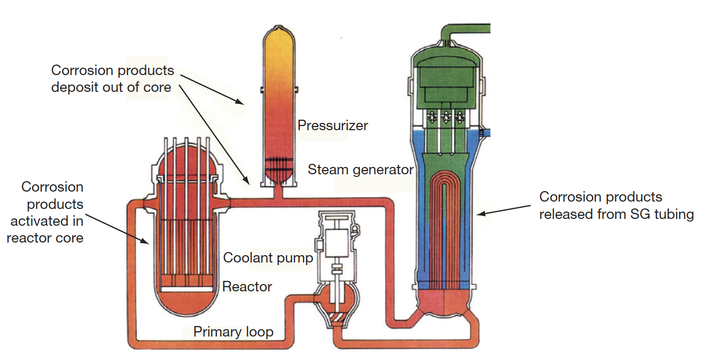
PWR Water Chemistry
In the very early days of PWR operation, heavy crud buildup on fuel cladding surfaces was caused by the transport of corrosion products from the steam generators into the reactor core
Activated corrosion products caused high-radiation fields on out-of-core surfaces fuel performance was compromised, and even coolant flow issues were observed

Slide 18
CRUD
A corrosion product called Chalk River unidentified deposit (CRUD) accumulates on the Ni alloy and stainless-steel surfaces
CRUD is an accumulation of materials and corrosion products that is composed of either dissolved ions or solid particles such as Ni, Fe, and Co on fuel rod cladding surfaces in NPPs
CRUD degrades heat production by nuclear fuel because it is slowly eroded by the circulation of the hot pressurized water and later deposited on the cladding or outer housing of fuel rods
The chemical composition of CRUD varies depending on the types of refueling cycles and the constituents of the basic metal material.
Irradiation can produce radionuclides in the CRUD, such as 60Co and 63Ni

Slide 19
PWR Water Chemistry
PWR problems were initially mitigated by imposing a hydrogen overpressure on the primary system, reducing the corrosion potential, and raising the primary chemistry pH
Commercial PWR power plants use a steadily decreasing concentration of boric acid as a chemical shim (for reactor control) throughout the fuel cycle, which results in the use of lithium hydroxide to control pH
The concept of ‘coordinated boron and lithium’ was developed, whereby the concentration of LiOH was gradually reduced in line with the boric acid reduction to maintain a constant pH
It was determined that heavy fuel crud buildup was avoided if a constant pH of at least 6.9 was maintained
Zinc injection is utilized to reduce radiation fields, and also inhibits SCC

Slide 20
Radiation Control
Corrosion products deposited on the fuel become activated, are released back into the coolant, and may be deposited on out-of-core surfaces
During shutdowns, the major radiation source for personnel exposure is activated corrosion products, deposited on primary system surfaces
The mechanism of the zinc ion effect is complex, as release of ⁶⁰Co from fuel crud is reduced, and deposition out-core is also reduced
Aqueous zinc ion promotes the formation of a more protective spinel-structured corrosion film on stainless steel, especially when reducing conditions are present
Both cobalt and zinc favor tetrahedral sites in the spinel structure, but the site preference energy favors zinc incorporation
The ⁶⁰Co remains longer in the water and is eventually removed by the cleanup system

Slide 21
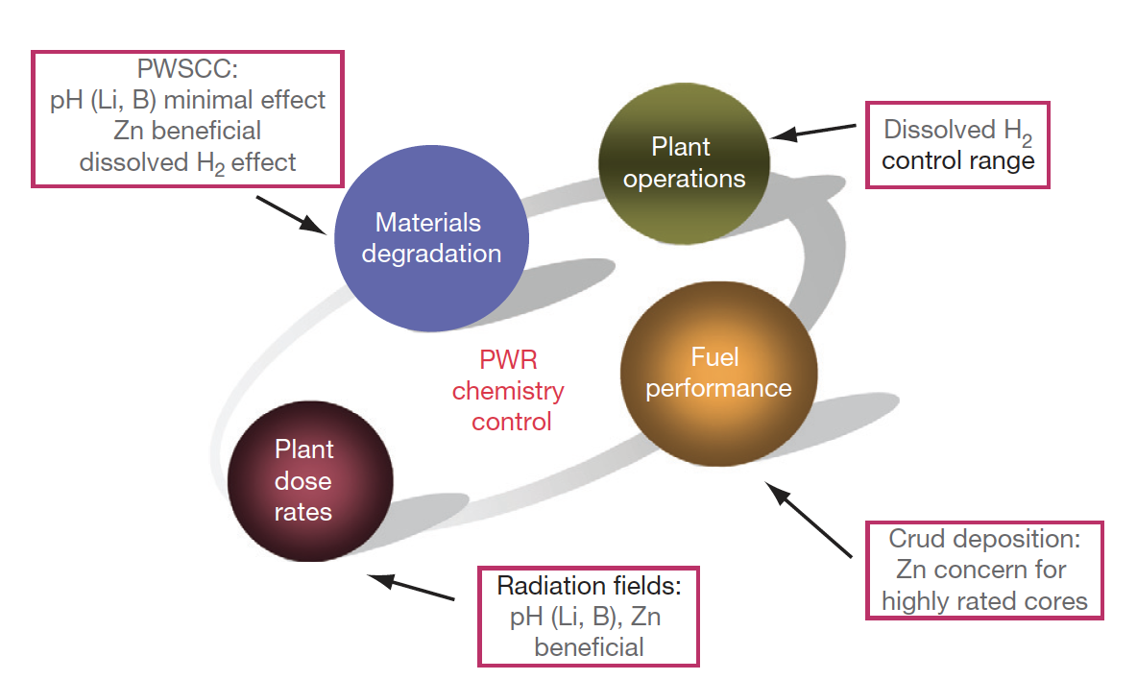
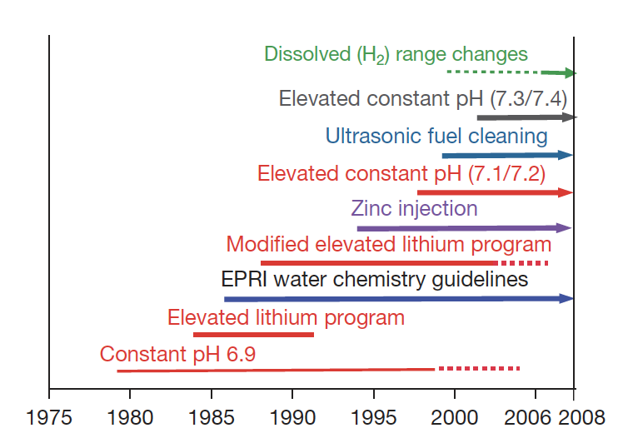
PWR Water Chemistry

Slide 22
Summary
Brief overview of water chemistry concerns
Primary system water chemistry affects fuel performance through the deposition of corrosion products on fuel pin surfaces
Control measures such as dissolved H2 and balancing LiOH to boron content are utilized to control the pH
Zinc injection is utilized to control radiation fields

Slide 23
Mechanistic Fuel Performance Modeling

Slide 24
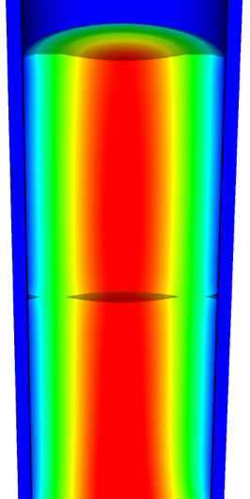
Going beyond burnup…
Operating Conditions
Neutron flux
Coolant T&P
Variables
Temperature
Displacement
Cladding
Property values
Fuel Property values
Fuel performance codes historically rely on materials models correlated to temperature and burn-up
Development has begun on models based on microstructure rather than burn-up
Elasticity tensor
Elasticity tensor
Burn-up
Yield stress
Thermal conductivity
Thermal conductivity
Fracture stress
Failure criteria
Melting temperature
Dimensional change
Diffusion constants
Gap conductance
Gap pressure
Dimensional change

Slide 25
Microstructure/Mechanistic/Multiscale
Mechanistic: relating to theories which explain phenomena in purely physical or deterministic terms
There is a drive for fuel performance codes to employ mechanistic materials models that are based on the current state of the evolving microstructure rather than burn-up
A series of state variables define the current state of the microstructure, and the evolution of these state variables is defined by mechanistic models that are functions of fuel conditions and other state variables
The material properties of the fuel and cladding are determined from microstructure/property relationships that are functions of the state variables and the current fuel conditions
Multiscale modeling and simulation is being used in conjunction with experimental data to inform the development of these models
This mechanistic, microstructure-based approach has the potential to provide a more predictive fuel performance capability

Slide 26
Multiscale Modeling
Modeling and simulation is the essential bridge from good science to good engineering, spanning from fundamental understanding of materials behavior to deliberate design of new materials technologies leveraging new properties and processes
Lower length scale modeling can provide insight, properties, mechanisms, behaviors, etc., that can be input into higher length scale modeling tools to describe, mechanistically, macroscale behavior

Slide 27
Density Functional Theory
DFT is a computational quantum mechanical modelling method used to investigate the electronic structure of many-body systems, in particular atoms, molecules, and the condensed phases
DFT is primarily utilized to investigate electronic structure, cohesive energy, elastic constants, phonons, entropies, etc.

Slide 28
Molecular Dynamics
MD is a computer simulation method for analyzing the physical movements of atoms and molecules, determined by numerically solving Newton's equations of motion for a system of interacting particles
MD is still atomistic, and is often utilized to calculate transport properties, melting temperature, clustering, etc., that are properties just beyond DFT capabilities

Slide 29
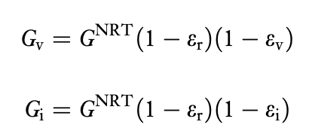
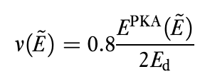
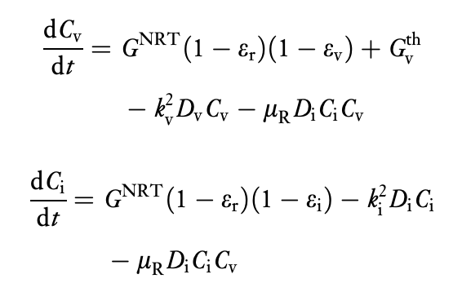
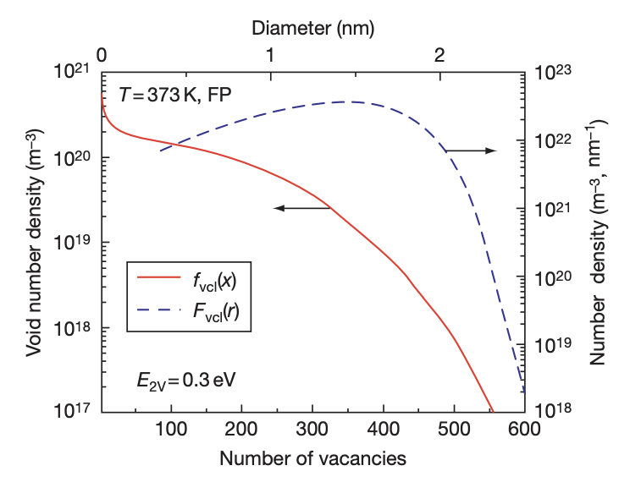
Rate Theory/Cluster Dynamics
Provides recipes for calculating reaction rates between individual species of the types which are ubiquitous in chemistry and physics
Is typically a mean-field approach which uses transition state theory as a tool for describing reactions involving radiation-produced defects
Can be utilized to describe clustering, absorption, emission, growth, resolution, etc. to describe microstructural phenomena on an intermediate time scale

Slide 30
Phase-Field
PF is mathematical model for solving interfacial problems that substitutes boundary conditions at the interface by a partial differential equation for the evolution of an auxiliary field (the phase field) that takes the role of an order parameter
The order parameter takes two distinct values (for instance 1 and 0) in each of the phases, with a smooth change between both values in the zone around the interface, which is then diffuse with a finite width
PF is commonly used for grain growth, phase separation, bubble coalescence, recrystallization, etc.

Slide 31

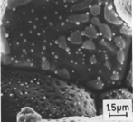
Microstructure-based fuel performance modeling
Structure/property relationships connect the microstructure variables to the property values
Operating Conditions
Neutron flux
Coolant T&P
Variables
Temperature
Displacement
Stoichiometry
Cladding
Property values
Microstructure evolution models
Microstructure evolution models
Fuel Property values
Elasticity tensor
Elasticity tensor
Grain growth
Grain growth
Cladding
Microstructure variables
Average grain size
Dislocation density
H concentration
Hydride fraction
Point defect concentrations
Loop density
2nd phase particle fraction
Fuel
Microstructure variables
Average grain size
Dislocation density
U defect concentrations
Pu concentration
Fission product precipitate fractions
Dissolved fission products
Fission gas bubble fraction
Grain boundary fission gas bubble coverage
Crack parameter
Plasticity
Plasticity
Thermal conductivity
Yield stress
Defect prod. & transport
Defect prod. & transport
Fracture stress
Thermal conductivity
Hydrogen transport
Fission gas behavior
Melting temperature
Failure criteria
Loop evolution
Densification
Diffusion constants
Dimensional change
Gap variable
Gap fission gas concentration
Fracture
Dimensional change

Slide 32

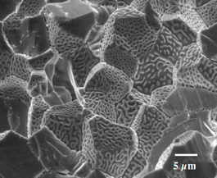
Example: fission gas behavior in the fuel
Take into account a finite set of variables to describe the state of the material
Utilize a mechanistic model of fission gas behavior to predict the evolution of the microstructure
Utilize this updated microstructure to inform a number of structure/property relationships
Variables
Temperature
Displacement
Stoichiometry
Elasticity tensor
Thermal conductivity
Model of fission gas behavior
Structure/property relationships
Fracture stress
Dissolved fission products
Fission gas bubble fraction
Grain boundary fission gas bubble coverage
Gap fission gas concentration
Dimensional change
Gap conductance
Gap pressure

Slide 33
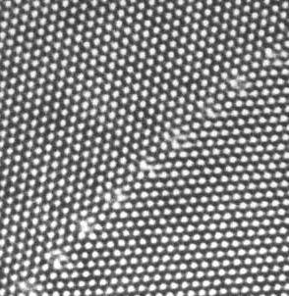
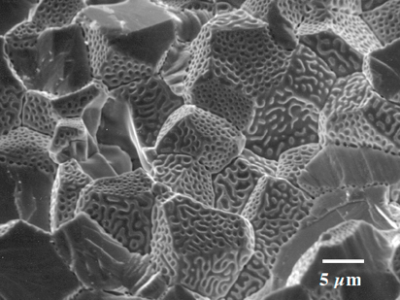
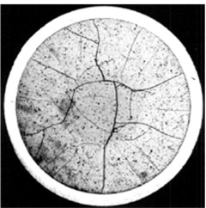
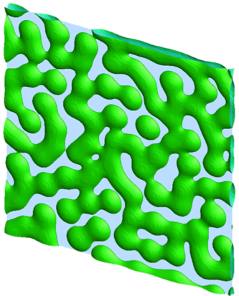
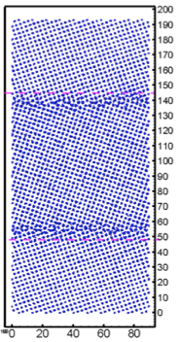
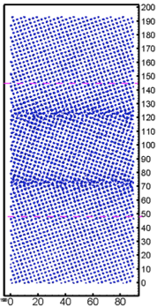
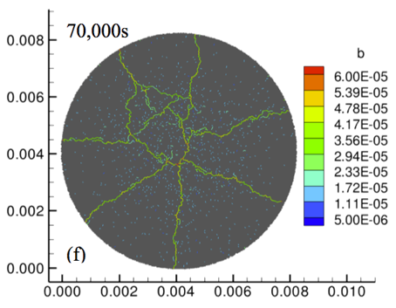
Multiscale separate effects experiments and simulations inform the development of the models
nm
μm
mm

Slide 34
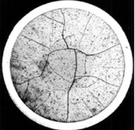
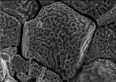
Microstructure-based models
Can provide a structure/property relationship to replace the existing burnup dependent model
For example, thermal conductivity, taking into account microstructural features and their evolution
Grain boundary and bubbles
Intragranular porosity
Precipitated fission products
κ_{pr}
Bulk conductivity
Vacancies and interstitials
Fission gas

Slide 35
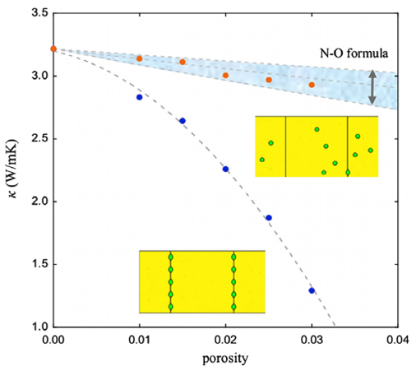
Parametrizing the mechanistic model
We employ multiscale modeling and simulation to determine the various parameters for the model
MD simulations conducted at LANL have been used to determine the coefficients for various point defects
MD simulations have shown that phonon scattering must be accounted for to accurately represent small bubbles
Mesoscale simulations have shown that GB bubbles have a larger impact on the thermal conductivity
Maxwell-Eucken (no phonon scattering)

Slide 36
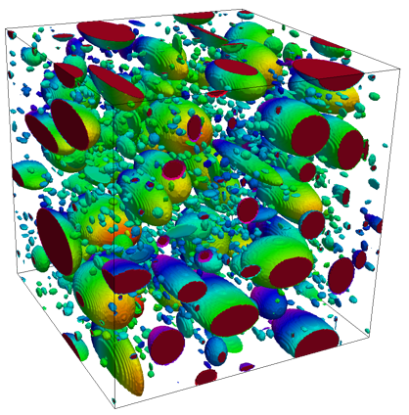
Parametrizing the mechanistic model
A thermal resistor model is created to describe the impact of GB bubbles on the thermal conductivity
MARMOT simulations are currently being used to inform the development of the precipitate multiplier

Slide 37
Parametrizing the mechanistic model
Each term in the expression must be coupled to a corresponding state variable
The full model calculates the thermal conductivity as a function of:
Temperature
Point defect concentrations
Intragranular bubble density and average radius
Fractional coverage of bubbles on GBs and average radius
Precipitate volume fractions and average sizes
Currently effects of precipitates fission products and individual point defects are neglected in the model, as they are not tracked or predicted in BISON

Slide 38
Comparing with experiments…
The model under-predicts the temperature in most cases, but not all
Thus, the model is neglecting some resistive effects from the microstructure
But generally performs as well, and in some cases better, than the burnup based model
RISO-3 AN3
RISO-3 AN4
RISO II-3
US PWR TSQ0002

Slide 39
UZr Fuel Performance Modeling
Development of a quantitative phase-field model of macroscale constituent redistribution in the U-Zr system, where model parameters were optimized and the model validated against an independent data set
Calculation of surface tension based on molecular dynamics, which is used in the BISON gaseous metallic fuel swelling model

Slide 40
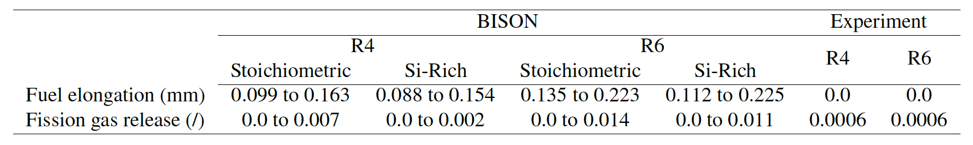
U3Si2 Fuel Performance Modeling
Point Defect Diffusion, Fission gas swelling, thermal and irradiation creep

Slide 41
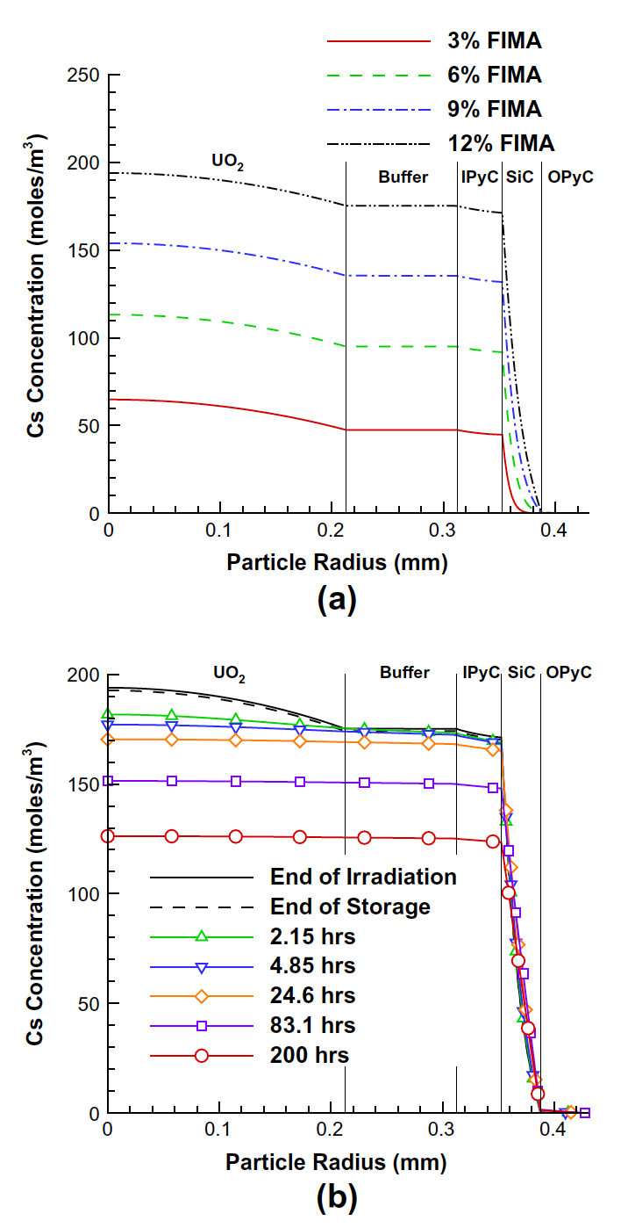
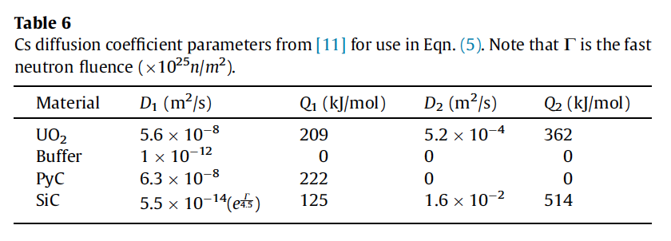
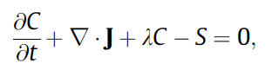
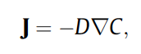
TRISO Particle Fuel Performance Modeling
TRISO particle modeling is still under development from a mechanistic model standpoint
Imperfect data for many critical fission products through different layers
Data typically for UO2 only, not for UC or UCO fuel kernels

Slide 42
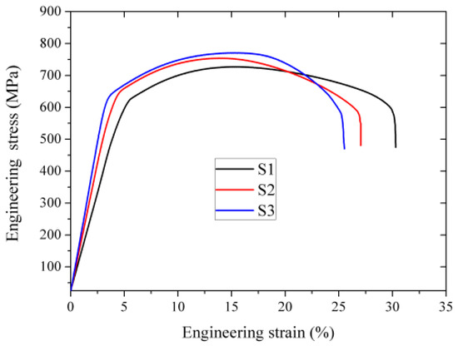
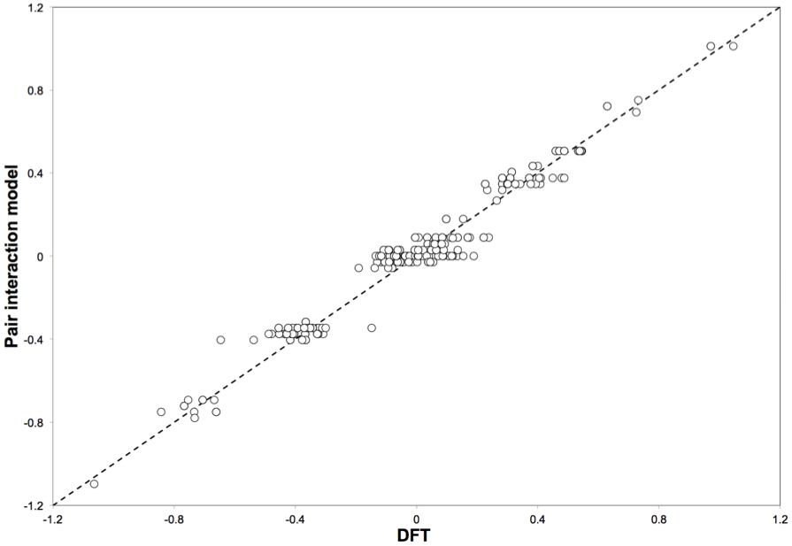
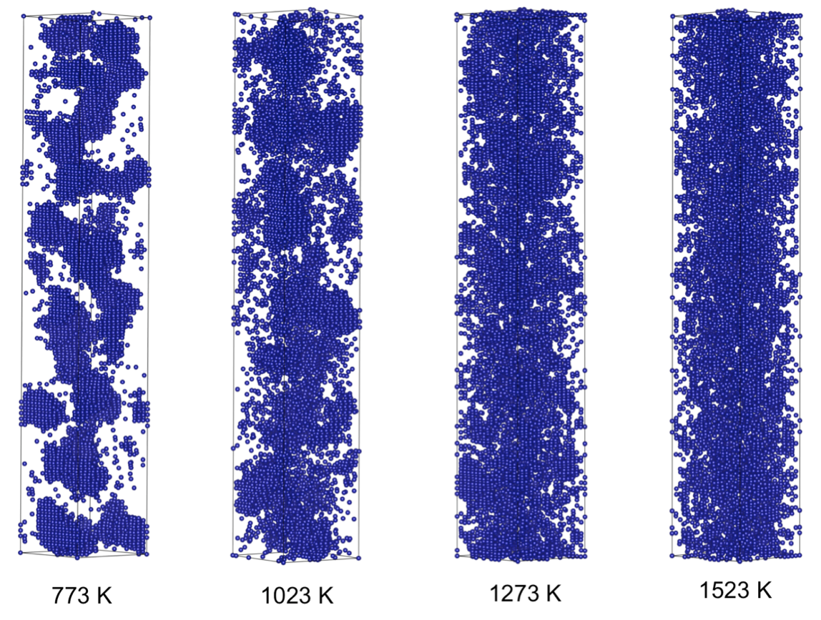
FeCrAl
Evolution of compositional randomness (precipitation) will affect the mechanical properties of FeCrAl
Kinetic Monte Carlo simulations modeled the precipitation of alpha’ phase from bcc Fe-Cr alloys under thermal aging at various temperatures
Fe-Al alloys do not show any phase separation
Can determine critical temperatures for precipitation and the resulting microstructures to investigate potential hardening

Slide 43
Summary
Researchers are working to develop materials models for the fuel and cladding that are mechanistic rather than empirical and that are based on the evolution of the microstructure rather than the burnup.

